Slide 1
Node JS

Slide 2
What is Node.js?
Node.js is an open-source server-side runtime environment built on Chrome's V8 JavaScript engine.
V8 is Google’s open-source JavaScript engine, which is written in C++.
It provides an event-driven, non-blocking (asynchronous) I/O and cross-platform runtime environment for building the highly scalable server-side application using JavaScript.
Node.js can be used to build different types of applications such as command line applications, web applications, real-time chat applications, REST API servers etc.
However, it is mainly used to build network programs like web servers, similar to PHP, Java, or ASP.NET.
Node.js was written and introduced by Ryan Dahl in 2009.

Slide 3
What is Node JS:-
Node.js is an open-source runtime environment.
It uses javascript on the server-side.
It is used for building web applications.
Based on google chrome’s v8 engine; it runs on various platforms such as windows, linux, mac, etc.
node.js uses asynchronous programming.
The popular frameworks built for node.js are express, sails, meteor, nest, koa, loopback, derby, and many more.
node.js is primarily used for event-driven servers, due to its single-threaded nature.
NPM is a package manager for the node javascript runtime environment.
it is a recommended feature for node.js installer.
It can manage packages that are local dependencies of a particular project and is the world’s largest online repository.

Slide 4
Node.js is not a language, or library, or framework.
It’s a runtime environment: typically JavaScript needs a browser to function, but Node.js creates suitable settings for JS to run outside of the browser.
It’s built on a JavaScript V8 engine that can run in Chrome, other browsers, or standalone.
The scope of V8 is to transform JS browser-oriented code into machine code — so JS becomes a general-purpose language and can be understood by servers.
This is one of the benefits of using Node.js in web app development: it broadens the functionality of JavaScript, allowing developers to integrate the language with APIs, other languages, and external libraries.

Slide 5
Thus, Node.js is a javascript runtime environment that runs on various platforms.
it can be used for building highly scalable, data-intensive, and real-time based web applications as it uses asynchronous programming which is memory efficient.

Slide 6
Advantages of Node.js
It is scalable and lightweight.
Provides high performance with fewer lines of code.
As it uses asynchronous programming, the non-blocking input output module solves performance issues.
Node.js modules which are similar to a set of javascript files make it easier to use. e) it is highly efficient as it allows handling multiple requests.
fast performance and data processing;
highly reusable code;
the code is easy to learn, write, read, and maintain;
huge resource library, thousands of free guides, and an active community.

Slide 7
Advantages of Node.js
Node.js is an open-source framework under MIT license. (MIT license is a free software license originating at the Massachusetts Institute of Technology (MIT).)
Uses JavaScript to build entire server side application.
Lightweight framework that includes bare minimum modules.
Other modules can be included as per the need of an application.
Asynchronous by default.
So it performs faster than other frameworks.
Cross-platform framework that runs on Windows, MAC or Linux

Slide 8
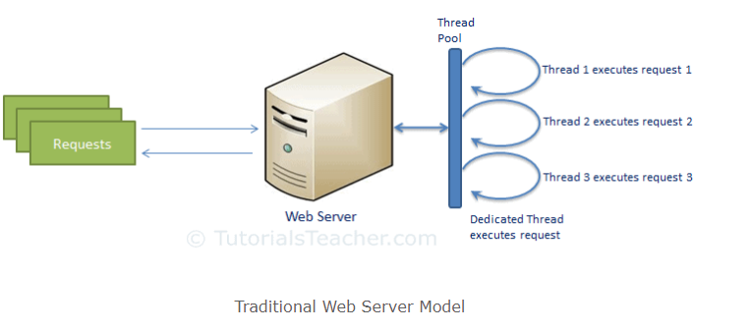
Traditional Web Server Model
In the traditional web server model, each request is handled by a dedicated thread from the thread pool.
If no thread is available in the thread pool at any point of time then the request waits till the next available thread.
Dedicated thread executes a particular request and does not return to the thread pool until it completes the execution and returns a response.

Slide 9
Node.js Process Model
Node.js processes user requests differently when compared to a traditional web server model.
Node.js runs in a single process and the application code runs in a single thread and thereby needs less resources than other platforms.
All the user requests to your web application will be handled by a single thread and all the I/O work or long running job is performed asynchronously for a particular request.
So, this single thread doesn't have to wait for the request to complete and is free to handle the next request.
When asynchronous I/O work completes then it processes the request further and sends the response.
An event loop is constantly watching for the events to be raised for an asynchronous job and executing callback function when the job completes.
Internally, Node.js uses libev for the event loop which in turn uses internal C++ thread pool to provide asynchronous I/O.
The following figure illustrates asynchronous web server model using Node.js.

Slide 10
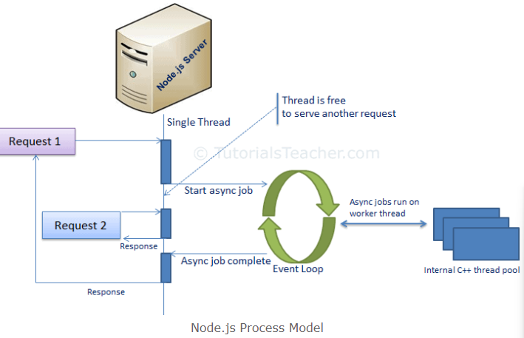

Slide 11
Web Applications
A web application, as you may already know, is a program that runs on a server and is rendered by a client browser, using the internet to access all the resources of that application. It usually can be easily broken down into three parts:
Client
Server
Database

Slide 12
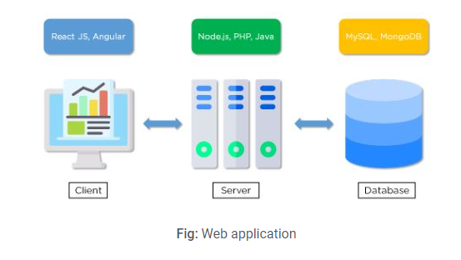

Slide 13
Client
The user interacts with the front-end part of a web application.
The front-end is usually developed using languages like HTML and CSS styles, along with extensive usage of JavaScript-based frameworks like ReactJS and Angular, which help with application design.
Server
The server is responsible for taking the client requests, performing the required tasks, and sending responses back to the clients.
It acts as a middleware between the front-end and stored data to enable operations on the data by a client.
Node.js, PHP, and Java are the most popular technologies in use to develop and maintain a web server.
Database
The database stores the data for a web application. The data can be created, updated, and deleted whenever the client requests.
MySQL and MongoDB are among the most popular databases used to store data for web applications.

Slide 14
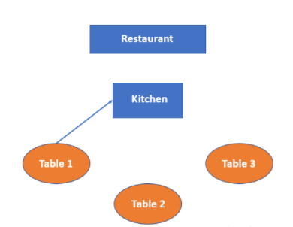
Working of Node.js
As mentioned earlier, node.js applications are highly-scalable due to its asynchronous i.e non-blocking nature. Let us consider a real-life application:
Imagine a restaurant; a waiter is allocated to serve the tables. a waiter comes and takes the order from table 1 and informs the kitchen; now the chef is busy preparing the order. Meanwhile, the waiter is now available to serve table 2 and table 3.

Slide 15
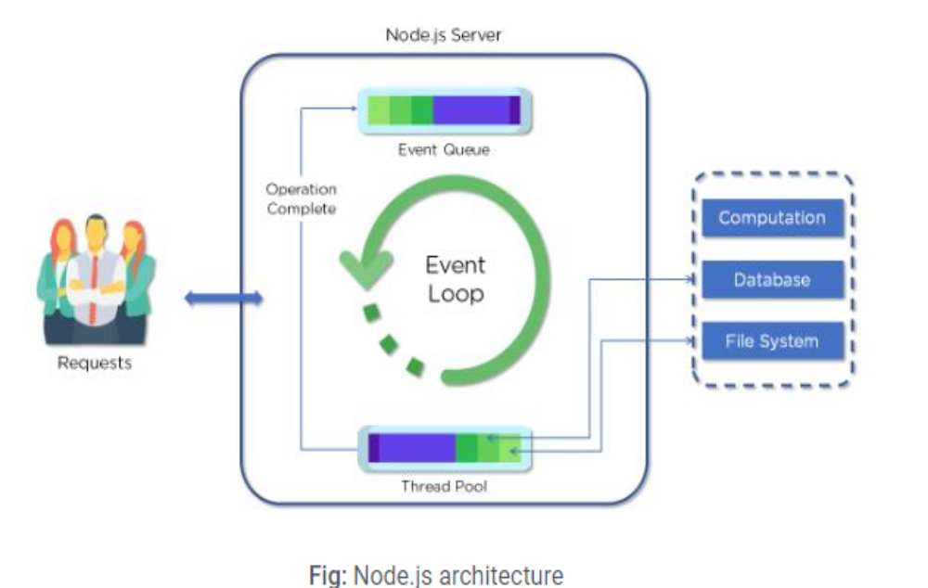
Node.js Server Architecture
Node.js uses the “Single Threaded Event Loop” architecture to handle multiple concurrent clients.
Node.js Processing Model is based on the JavaScript event-based model along with the JavaScript callback mechanism.

Slide 16
Parts of the Node.js Architecture:
Requests
Incoming requests can be blocking (complex) or non-blocking (simple), depending upon the tasks that a user wants to perform in a web application
Node.js Server
Node.js server is a server-side platform that takes requests from users, processes those requests, and returns responses to the corresponding users
Event Queue
Event Queue in a Node.js server stores incoming client requests and passes those requests one-by-one into the Event Loop

Slide 17
Thread Pool
Thread pool consists of all the threads available for carrying out some tasks that might be required to fulfill client requests
Event Loop
Event Loop indefinitely receives requests and processes them, and then returns the responses to corresponding clients
External Resources
External resources are required to deal with blocking client requests. These resources can be for computation, data storage, etc.

Slide 18
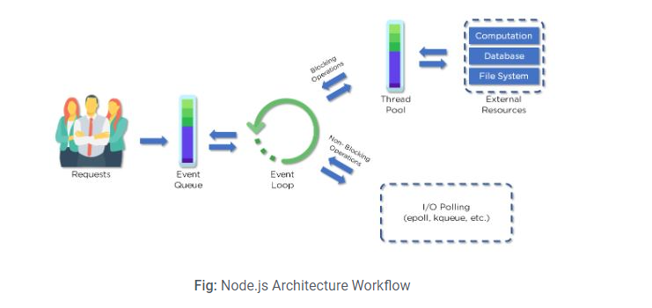
The Workflow of Node.js Architecture:
A web server developed using Node.js typically has a workflow that is quite similar to the diagram illustrated below. Let’s explore this flow of operations in detail.

Slide 19
Clients send requests to the webserver to interact with the web application. Requests can be non-blocking or blocking:
-Querying for data
-Deleting data
-Updating the data
Node.js retrieves the incoming requests and adds those requests to the Event Queue
The requests are then passed one-by-one through the Event Loop.
It checks if the requests are simple enough to not require any external resources
Event Loop processes simple requests (non-blocking operations), such as I/O Polling, and returns the responses to the corresponding clients

Slide 20
A single thread from the Thread Pool is assigned to a single complex request.
This thread is responsible for completing a particular blocking request by accessing the external resources, such as compute, database, file system, etc.
Once, the task is carried out completely, the response is sent to the Event Loop that in turn sends that response back to the Client

Slide 21
Node.JS applications are asynchronous by default. as the above figure depicts, a single thread is allocated to handle a request;
where this single thread is used to handle multiple requests.
When a request arrives, a single thread is allocated to handle that request.
If we have to query the database, our thread doesn’t have to wait for the database to return the data;
while the database is executing our query, that thread will be used to serve another client.
When the database prepares the result, it returns the content to the client. this kind of architecture makes node.js ideal for building data-intensive applications.

Slide 22
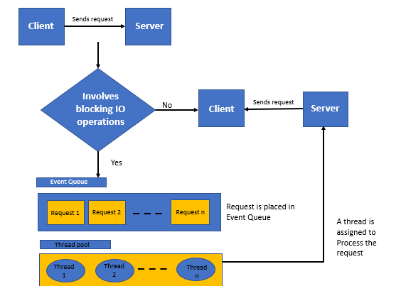
Architecture of Node.js
Node.JS is based on single threaded event loop model. Its processing is mainly based on the javascript event loop model.

Slide 23
Client sends request to Server.
Node.js web server internally maintains a thread pool to provide services to the client.
the requests received at the node.js web server are placed into the queue, which is also called an event queue.
Event loop operates on a single thread only.
When a request is placed in the Event Queue, the Node.JS web server starts processing that particular client request.
If processing a particular client request does not involve any blocking input-output operations, then that request is processed; the response is prepared and sent back to the client.

Slide 24
If processing a particular client request does involve blocking input output operations like interacting to an external service or querying a database, a different approach is followed.
Thread availability check is performed at Internal Thread Pool.
It then picks up a thread an assigns this client request to that
That thread is then responsible for taking that request ahead, processing it, performing blocking operations, preparing the response, and sending it back to the Event loop.
The event loop in turn, sends the response back to the client.

Slide 25
The following diagram will help us understand the architecture of Node.JS: a) In the above diagram, there are “n” numbers of the client sending requests to our Node.JS server.
Suppose our clients are Client-1, Client-2 …..Client-n.
Our Node.js web server has an internal thread pool consisting of “n” number of threads.
On receiving multiple client requests, the web server places them into the Event Queue.
Now, the Event loop operates on all requests one by one.

Slide 26
At first, the event loop picks up the client-1 request-1
Performs check if the client-1 request-1 requires any blocking input output operations or interaction with the database.
As this particular request is simple and does not involve any complex operations, it does not require any separate thread to process it.
Event loop then processes the client-1 request-1 and prepares the response-1
Event loop sends the response-1 to client-1

Slide 27
Event loop picks up the client-2 request-2
Checks whether if the client-2 request-2 requires any blocking input output operations or an interaction with database.
As this particular request is not simple and requires blocking input output operations or more complex operations, the event loop assigns a thread-1 to this request.
Thread T-1 now processes the request-2, performs all complex operations and prepares response-2.
Thread T-1 then sends this response to the event loop.
The event loop in turn, sends the response-2 to client-2.

Slide 28
Examples of Node.js
There are several companies using node.js to build their applications. For example, paypal(online payment platform), netflix(biggest streaming media), uber (a platform that connects cab drivers to customers), ebay(multinational e-commerce function), walmart(world’s largest retail chain), linkedin(biggest social-networking platform dedicated to business and employment) and many more.

Slide 29
Advantages of Node.js Architecture
Node.js Architecture comes with several advantages that give the server-side platform a distinct upper-hand when compared to other server-side languages:
Handling multiple concurrent client requests is fast and easy
With the use of Event Queue and Thread Pool, the Node.js server enables efficient handling of a large number of incoming requests.
No need for creating multiple threads
Event Loop handles all requests one-by-one, so there is no need to create multiple threads.
Instead, a single thread is sufficient to handle a blocking incoming request.

Slide 30
Requires fewer resources and memory
Node.js server, most of the time, requires fewer resources and memory due to the way it handles the incoming requests.
Since the requests are processed one at a time, the overall process becomes less taxing on the memory.

Slide 31
Local Environment Setup
If you are still willing to set up your environment for Node.js, you need the following two softwares available on your computer,
(a) Text Editor and (b) The Node.js binary installables.
https://nodejs.org/en/download/
Verify installation: Executing a File
$node –v
$node hello.js

Slide 32
A Node.js application consists of the following three important components −
Import required modules − We use the require directive to load Node.js modules.
Create server − A server which will listen to client's requests similar to Apache HTTP Server.
Read request and return response − The server created in an earlier step will read the HTTP request made by the client which can be a browser or a console and return the response.

Slide 33
Creating Node.js Application
Step 1 - Import Required Module
We use the require directive to load the http module and store the returned HTTP instance into an http variable as follows −
var http = require("http");

Slide 34
Step 2 - Create Server
We use the created http instance and call http.createServer() method to create a server instance and then we bind it at port 8081 using the listen method associated with the server instance.
Pass it a function with parameters request and response. Write the sample implementation to always return "Hello World".
http.createServer(function (request, response) {
// Send the HTTP header
// HTTP Status: 200 : OK
// Content Type: text/plain
response.writeHead(200, {'Content-Type': 'text/plain'});
// Send the response body as "Hello World"
response.end('Hello World\n');
}).listen(8081);
// Console will print the message
console.log('Server running at http://127.0.0.1:8081/');
The above code is enough to create an HTTP server which listens, i.e., waits for a request over 8081 port on the local machine.

Slide 35
Step 3 - Testing Request & Response
Let's put step 1 and 2 together in a file called main.js and start our HTTP server as shown below −
var http = require("http");
http.createServer(function (request, response) {
// Send the HTTP header
// HTTP Status: 200 : OK
// Content Type: text/plain
response.writeHead(200, {'Content-Type': 'text/plain'});
// Send the response body as "Hello World"
response.end('Hello World\n');
}).listen(8081);
// Console will print the message
console.log('Server running at http://127.0.0.1:8081/');

Slide 36
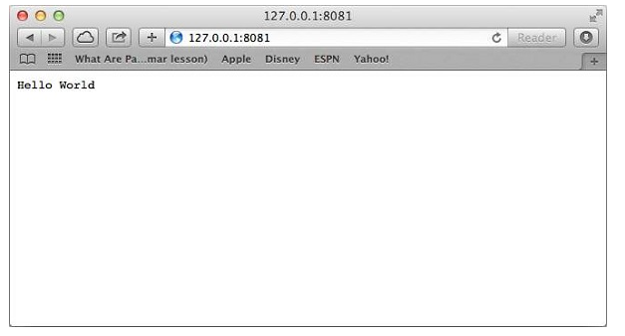
Now execute the main.js to start the server as follows −
$ node main.js
Verify the Output. Server has started.
Server running at http://127.0.0.1:8081/
Make a Request to the Node.js Server
Open http://127.0.0.1:8081/ in any browser and observe the following result.

Slide 37
REPL stands for Read Eval Print Loop and it represents a computer environment like a Windows console or Unix/Linux shell where a command is entered and the system responds with an output in an interactive mode.
Node.js or Node comes bundled with a REPL environment. It performs the following tasks −
Read − Reads user's input, parses the input into JavaScript data-structure, and stores in memory.
Eval − Takes and evaluates the data structure.
Print − Prints the result.
Loop − Loops the above command until the user presses ctrl-c twice.

Slide 38
Starting REPL
REPL can be started by simply running node on shell/console without any arguments as follows.
$ node
You will see the REPL Command prompt > where you can type any Node.js command −
$ node
>
> 1 + 3
4
> 1 + ( 2 * 3 ) - 4
3
>

Slide 39
> x = 10
10
> var y = 10
undefined
> x + y
20
> console.log("Hello World")
Hello World
undefined

Slide 40
Multiline Expression
> var x = 0
undefined
> do {
... x++;
... console.log("x: " + x);
... }
while ( x < 5 );
x: 1
x: 2
x: 3
x: 4
x: 5

Slide 41
Node Package Manager (NPM) provides two main functionalities −
Online repositories for node.js packages/modules which are searchable on search.nodejs.org
Command line utility to install Node.js packages, do version management and dependency management of Node.js packages.
NPM comes bundled with Node.js installables after v0.6.3 version. To verify the same, open console and type the following command and see the result −
$ npm --version
2.7.1

Slide 42
Installing Modules using NPM
There is a simple syntax to install any Node.js module −
$ npm install <Module Name>
For example, following is the command to install a famous Node.js web framework module called express −
$ npm install express
Now you can use this module in your js file as following −
var express = require('express');
Uninstalling a Module
Use the following command to uninstall a Node.js module.
$ npm uninstall express

Slide 43
Updating a Module
Update package.json and change the version of the dependency to be updated and run the following command.
$ npm update express
Search a Module
Search a package name using NPM.
$ npm search express

Slide 44
What is Callback?
Callback is an asynchronous equivalent for a function.
A callback function is called at the completion of a given task.
Node makes heavy use of callbacks.
All the APIs of Node are written in such a way that they support callbacks.
For example, a function to read a file may start reading file and return the control to the execution environment immediately so that the next instruction can be executed.
Once file I/O is complete, it will call the callback function while passing the callback function, the content of the file as a parameter.
So there is no blocking or wait for File I/O.
This makes Node.js highly scalable, as it can process a high number of requests without waiting for any function to return results.

Slide 45
Blocking Code Example
Create a text file named input.txt with the following content −
Create a js file named main.js with the following code −
var fs = require("fs");
var data = fs.readFileSync('input.txt');
console.log(data.toString());
console.log("Program Ended");
$ node main.js

Slide 46
Non-Blocking Code Example
var fs = require("fs");
fs.readFile('input.txt', function (err, data) {
if (err) return console.error(err);
console.log(data.toString());
});
console.log("Program Ended");
$ node main.js

Slide 47
These two examples explain the concept of blocking and non-blocking calls.
The first example shows that the program blocks until it reads the file and then only it proceeds to end the program.
The second example shows that the program does not wait for file reading and proceeds to print "Program Ended" and at the same time, the program without blocking continues reading the file.

Slide 48
Node.js - Event Loop
Node.js is a single-threaded application, but it can support concurrency via the concept of event and callbacks.
Every API of Node.js is asynchronous and being single-threaded, they use async function calls to maintain concurrency.
Node uses observer pattern.
Node thread keeps an event loop and whenever a task gets completed, it fires the corresponding event which signals the event-listener function to execute.

Slide 49
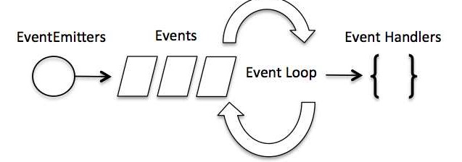
Event-Driven Programming
In an event-driven application, there is generally a main loop that listens for events, and then triggers a callback function when one of those events is detected.

Slide 50
Although events look quite similar to callbacks, the difference lies in the fact that callback functions are called when an asynchronous function returns its result, whereas event handling works on the observer pattern.
The functions that listen to events act as Observers.
Whenever an event gets fired, its listener function starts executing.
Node.js has multiple in-built events available through events module and EventEmitter class which are used to bind events and event-listeners as follows −
// Import events module
var events = require('events');
// Create an eventEmitter object
var eventEmitter = new events.EventEmitter();
Following is the syntax to bind an event handler with an event −
// Bind event and event handler as follows
eventEmitter.on('eventName', eventHandler);
We can fire an event programmatically as follows −
// Fire an event
eventEmitter.emit('eventName');

Slide 51
Example
// Import events module
var events = require('events');
// Create an eventEmitter object
var eventEmitter = new events.EventEmitter();
// Create an event handler as follows
var connectHandler = function connected() {
console.log('connection succesful.');
// Fire the data_received event
eventEmitter.emit('data_received');
}
// Bind the connection event with the handler
eventEmitter.on('connection', connectHandler);
// Bind the data_received event with the anonymous function
eventEmitter.on('data_received', function() {
console.log('data received succesfully.');
});
// Fire the connection event
eventEmitter.emit('connection');
console.log("Program Ended.");

Slide 52
$ node main.js
connection successful.
data received successfully.
Program Ended.

Slide 53
How Node Applications Work?
In Node Application, any async function accepts a callback as the last parameter and a callback function accepts an error as the first parameter.
var fs = require("fs");
fs.readFile('input.txt', function (err, data) {
if (err) {
console.log(err.stack);
return;
}
console.log(data.toString());
});
console.log("Program Ended");

Slide 54
Here fs.readFile() is a async function whose purpose is to read a file.
If an error occurs during the read operation, then the err object will contain the corresponding error, else data will contain the contents of the file.
readFile passes err and data to the callback function after the read operation is complete, which finally prints the content.

Slide 55
Node.js - Event Emitter
Many objects in a Node emit events, for example, a net.Server emits an event each time a peer connects to it, an fs.readStream emits an event when the file is opened.
All objects which emit events are the instances of events.EventEmitter.
EventEmitter Class
As we have seen in the previous section, EventEmitter class lies in the events module.
It is accessible via the following code −
// Import events module
var events = require('events');
// Create an eventEmitter object
var eventEmitter = new events.EventEmitter();

Slide 56
Node.js - File System
The Node File System (fs) module can be imported using the following syntax −
var fs = require("fs")
Synchronous vs Asynchronous
Every method in the fs module has synchronous as well as asynchronous forms.
Asynchronous methods take the last parameter as the completion function callback and the first parameter of the callback function as error.
It is better to use an asynchronous method instead of a synchronous method, as the former never blocks a program during its execution, whereas the second one does.

Slide 57
var fs = require("fs");
// Asynchronous read
fs.readFile('input.txt', function (err, data) {
if (err) {
return console.error(err);
}
console.log("Asynchronous read: " + data.toString());
});
// Synchronous read
var data = fs.readFileSync('input.txt');
console.log("Synchronous read: " + data.toString());
console.log("Program Ended");

Slide 58
$ node main.js
C:\2021_22\ODD\IP\NodeExample>node file1.js
Synchronous read: Node js
Node File system
Program Ended
Asynchronous read: Node js
Node File system

Slide 59
Open a File
Syntax
fs.open(path, flags[, mode], callback)
Parameters
Here is the description of the parameters used −
path − This is the string having file name including path.
flags − Flags indicate the behavior of the file to be opened. All possible values have been mentioned below.
mode − It sets the file mode (permission and sticky bits), but only if the file was created. It defaults to 0666, readable and writeable.
callback − This is the callback function which gets two arguments (err, fd).

Slide 60
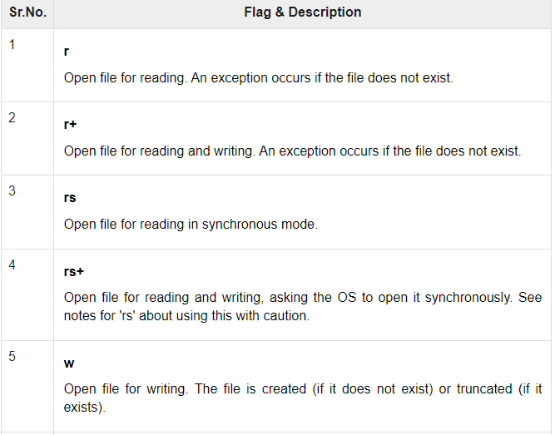

Slide 61
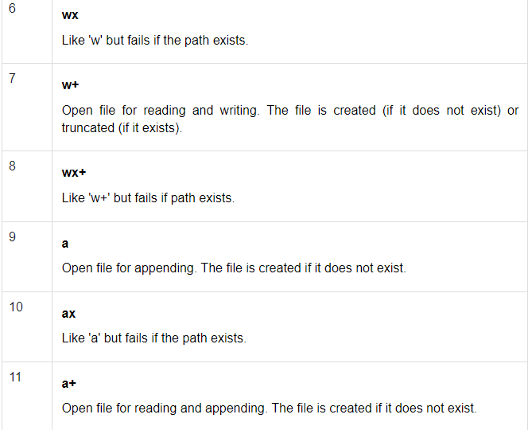

Slide 62
Let us create a js file named main.js having the following code to open a file input.txt for reading and writing.
var fs = require("fs");
// Asynchronous - Opening File
console.log("Going to open file!");
fs.open('input.txt', 'r+', function(err, fd) {
if (err) {
return console.error(err);
}
console.log("File opened successfully!");
});
$ node main.js
Going to open file!
File opened successfully!

Slide 63
var fs = require("fs");
console.log("Going to get file info!");
fs.stat('input.txt', function (err, stats) {
if (err) {
return console.error(err);
}
console.log(stats);
console.log("Got file info successfully!");
// Check file type
console.log("isFile ? " + stats.isFile());
console.log("isDirectory ? " + stats.isDirectory());
});

Slide 64
Writing a File
Syntax
Following is the syntax of one of the methods to write into a file −
fs.writeFile(filename, data[, options], callback)
This method will over-write the file if the file already exists. If you want to write into an existing file then you should use another method available.
Parameters
Here is the description of the parameters used −
path − This is the string having the file name including path.
data − This is the String or Buffer to be written into the file.
options − The third parameter is an object which will hold {encoding, mode, flag}. By default. encoding is utf8, mode is octal value 0666. and flag is 'w'
callback − This is the callback function which gets a single parameter err that returns an error in case of any writing error.

Slide 65
var fs = require("fs");
console.log("Going to write into existing file");
fs.writeFile('input.txt', 'Simply Easy Learning!', function(err) {
if (err) {
return console.error(err);
}
console.log("Data written successfully!");
console.log("Let's read newly written data");
fs.readFile('input.txt', function (err, data) {
if (err) {
return console.error(err);
}
console.log("Asynchronous read: " + data.toString());
});
});

Slide 66
Reading a File
Syntax
fs.read(fd, buffer, offset, length, position, callback)
This method will use file descriptor to read the file. If you want to read the file directly using the file name, then you should use another method available.
Parameters
Here is the description of the parameters used −
fd − This is the file descriptor returned by fs.open().
buffer − This is the buffer that the data will be written to.
offset − This is the offset in the buffer to start writing at.
length − This is an integer specifying the number of bytes to read.
position − This is an integer specifying where to begin reading from in the file. If position is null, data will be read from the current file position.
callback − This is the callback function which gets the three arguments, (err, bytesRead, buffer).

Slide 67
var fs = require("fs");
var buf = new Buffer(1024);
console.log("Going to open an existing file");
fs.open('input.txt', 'r+', function(err, fd) {
if (err) {
return console.error(err);
}
console.log("File opened successfully!");
console.log("Going to read the file");
fs.read(fd, buf, 0, buf.length, 0, function(err, bytes){
if (err){
console.log(err);
}
console.log(bytes + " bytes read");
// Print only read bytes to avoid junk.
if(bytes > 0){
console.log(buf.slice(0, bytes).toString());
}
});
});

Slide 68
Closing a File
Syntax
Following is the syntax to close an opened file −
fs.close(fd, callback)
Parameters
Here is the description of the parameters used −
fd − This is the file descriptor returned by file fs.open() method.
callback − This is the callback function No arguments other than a possible exception are given to the completion callback.

Slide 69
var fs = require("fs");
var buf = new Buffer(1024);
console.log("Going to open an existing file");
fs.open('input.txt', 'r+', function(err, fd) {
if (err) {
return console.error(err);
}
console.log("File opened successfully!");
console.log("Going to read the file");
fs.read(fd, buf, 0, buf.length, 0, function(err, bytes) {
if (err) {
console.log(err);
}
// Print only read bytes to avoid junk.
if(bytes > 0) {
console.log(buf.slice(0, bytes).toString());
}

Slide 70
// Close the opened file.
fs.close(fd, function(err) {
if (err) {
console.log(err);
}
console.log("File closed successfully.");
});
});
});

Slide 71
fs.mkdir(path[, mode], callback)
fs.rmdir(path, callback)
fs.readdir(path, callback)
fs.unlink(path, callback)

Slide 72
Node.js - Web Module
What is a Web Server?
A Web Server is a software application which handles HTTP requests sent by the HTTP client, like web browsers, and returns web pages in response to the clients. Web servers usually deliver html documents along with images, style sheets, and scripts.
Most of the web servers support server-side scripts, using scripting languages or redirecting the task to an application server which retrieves data from a database and performs complex logic and then sends a result to the HTTP client through the Web server.
Apache web server is one of the most commonly used web servers.
It is an open source project.

Slide 73
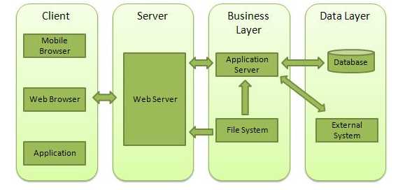
Web Application Architecture
A Web application is usually divided into four layers −

Slide 74
Client − This layer consists of web browsers, mobile browsers or applications which can make HTTP requests to the web server.
Server − This layer has the Web server which can intercept the requests made by the clients and pass them the response.
Business − This layer contains the application server which is utilized by the web server to do the required processing. This layer interacts with the data layer via the database or some external programs.
Data − This layer contains the databases or any other source of data.

Slide 75
Creating a Web Server using Node
Node.js provides an http module which can be used to create an HTTP client of a server.
Following is the bare minimum structure of the HTTP server which listens at 8081 port.
Create a js file named server.js −
File: server.js

Slide 76
var http = require('http');
var fs = require('fs');
var url = require('url');
// Create a server
http.createServer( function (request, response) {
// Parse the request containing file name
var pathname = url.parse(request.url).pathname;
// Print the name of the file for which request is made.
console.log("Request for " + pathname + " received.");
// Read the requested file content from file system
fs.readFile(pathname.substr(1), function (err, data) {
if (err) {
console.log(err);
// HTTP Status: 404 : NOT FOUND
// Content Type: text/plain
response.writeHead(404, {'Content-Type': 'text/html'});
} else {

Slide 77
//Page found
// HTTP Status: 200 : OK
// Content Type: text/plain
response.writeHead(200, {'Content-Type': 'text/html'});
// Write the content of the file to response body
response.write(data.toString());
}
// Send the response body
response.end();
});
}).listen(8081);
// Console will print the message
console.log('Server running at http://127.0.0.1:8081/');

Slide 78
Express JS

Slide 79
Express Overview
Express is a minimal and flexible Node.js web application framework that provides a robust set of features to develop web and mobile applications.
It facilitates the rapid development of Node based Web applications. Following are some of the core features of Express framework −
Allows to set up middlewares to respond to HTTP Requests.
Defines a routing table which is used to perform different actions based on HTTP Method and URL.
Allows to dynamically render HTML Pages based on passing arguments to templates.

Slide 80
Installing Express
Firstly, install the Express framework globally using NPM so that it can be used to create a web application using node terminal.
$ npm install express –save
The above command saves the installation locally in the node_modules directory and creates a directory express inside node_modules.
You should install the following important modules along with express −
body-parser − This is a node.js middleware for handling JSON, Raw, Text and URL encoded form data.
cookie-parser − Parse Cookie header and populate req.cookies with an object keyed by the cookie names.
multer − This is a node.js middleware for handling multipart/form-data.

Slide 81
$ npm install body-parser --save
$ npm install cookie-parser --save
$ npm install multer --save

Slide 82
Hello world Example
Following is a very basic Express app which starts a server and listens on port 8081 for connection.
This app responds with Hello World! for requests to the homepage.
For every other path, it will respond with a 404 Not Found.
var express = require('express');
var app = express();
app.get('/', function (req, res) {
res.send('Hello World');
})
var server = app.listen(8081, function () {
var host = server.address().address
var port = server.address().port
console.log("Example app listening at http://%s:%s", host, port)
})

Slide 83
Express JS

Slide 84
ExpressJS is a web application framework that provides you with a simple API to build websites, web apps and back ends.
With ExpressJS, you need not worry about low level protocols, processes, etc.
What is Express?
Express provides a minimal interface to build our applications.
It provides us the tools that are required to build our app.
It is flexible as there are numerous modules available on npm, which can be directly plugged into Express.

Slide 85
Node Package Manager(npm)
npm is the package manager for node.
The npm Registry is a public collection of packages of open-source code for Node.js, front-end web apps, mobile apps, robots, routers, and countless other needs of the JavaScript community.
npm allows us to access all these packages and install them locally.
You can browse through the list of packages available on npm at npmJS.
How to use npm?
There are two ways to install a package using npm: globally and locally.
Globally − This method is generally used to install development tools and CLI based packages.
To install a package globally, use the following code.

Slide 86
npm install -g <package-name>
Locally − This method is generally used to install frameworks and libraries.
A locally installed package can be used only within the directory it is installed.
To install a package locally, use the same command as above without the -g flag.
npm install <package-name>
Whenever we create a project using npm, we need to provide a package.json file, which has all the details about our project.
npm makes it easy for us to set up this file. Let us set up our development project.

Slide 87
Step 1 − Start your terminal/cmd, create a new folder named hello-world and cd (create directory) into it −
npm init info
Step 2 − Now to create the package.json file using npm, use the following code.
npm init

Slide 88
var express = require('express');
var app = express();
app.get('/hello', function(req, res){
res.send("Hello World!");
});
app.listen(3000);

Slide 89
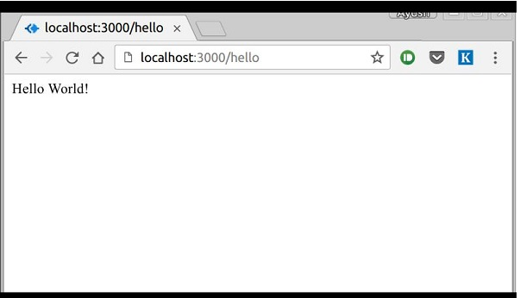
If we run our application and go to localhost:3000/hello, the server receives a get request at route "/hello", our Express app executes the callback function attached to this route and sends "Hello World!" as the response.

Slide 90
How the App Works?
The first line imports Express in our file, we have access to it through the variable Express. We use it to create an application and assign it to var app.
app.get(route, callback)
This function tells what to do when a get request at the given route is called.
The callback function has 2 parameters, request(req) and response(res).
The request object(req) represents the HTTP request and has properties for the request query string, parameters, body, HTTP headers, etc. Similarly, the response object represents the HTTP response that the Express app sends when it receives an HTTP request.

Slide 91
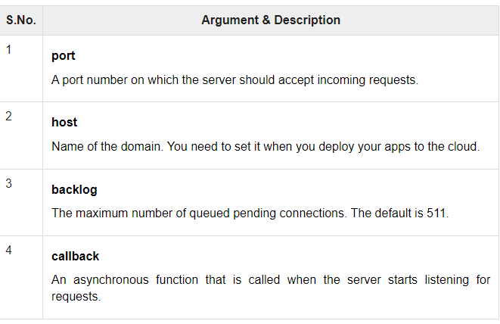
res.send()
This function takes an object as input and it sends this to the requesting client. Here we are sending the string "Hello World!".
app.listen(port, [host], [backlog], [callback]])
This function binds and listens for connections on the specified host and port. Port is the only required parameter here.

Slide 92
ExpressJS - Routing
Web frameworks provide resources such as HTML pages, scripts, images, etc. at different routes.
The following function is used to define routes in an Express application −
app.method(path, handler)
This METHOD can be applied to any one of the HTTP verbs – get, set, put, delete. An alternate method also exists, which executes independent of the request type.
Path is the route at which the request will run.
Handler is a callback function that executes when a matching request type is found on the relevant route. For example,
var express = require('express');
var app = express();
app.get('/hello', function(req, res){
res.send("Hello World!");
});
app.listen(3000);

Slide 93
ExpressJS - URL Building
We can now define routes, but those are static or fixed. To use the dynamic routes, we SHOULD provide different types of routes. Using dynamic routes allows us to pass parameters and process based on them.
Here is an example of a dynamic route −
var express = require('express');
var app = express();
app.get('/:id', function(req, res){
res.send('The id you specified is ' + req.params.id);
});
app.listen(3000);

Slide 94
Routing:
We can now define routes, but those are static or fixed. To use the dynamic routes, we SHOULD provide different types of routes. Using dynamic routes allows us to pass parameters and process based on them.
Here is an example of a dynamic route −
var express = require('express');
var app = express();
app.get('/:id', function(req, res){
res.send('The id you specified is ' + req.params.id);
});
app.listen(3000);

Slide 95
Pattern Matched Routes
You can also use regex to restrict URL parameter matching. Let us assume you need the id to be a 5-digit long number. You can use the following route definition −
var express = require('express');
var app = express();
app.get('/things/:id([0-9]{5})', function(req, res){
res.send('id: ' + req.params.id);
});
app.listen(3000);

Slide 96
ExpressJS - Middleware
Middleware functions are functions that have access to the request object (req), the response object (res), and the next middleware function in the application’s request-response cycle.
These functions are used to modify req and res objects for tasks like parsing request bodies, adding response headers, etc.

Slide 97
Routing
Routing refers to how an application’s endpoints (URIs) respond to client requests. For an introduction to routing, see Basic routing.
You define routing using methods of the Express app object that correspond to HTTP methods; for example, app.get() to handle GET requests and app.post to handle POST requests. For a full list, see app.METHOD.
You can also use app.all() to handle all HTTP methods and app.use() to specify middleware as the callback function (See Using middleware for details).
These routing methods specify a callback function (sometimes called “handler functions”) called when the application receives a request to the specified route (endpoint) and HTTP method. In other words, the application “listens” for requests that match the specified route(s) and method(s), and when it detects a match, it calls the specified callback function.

Slide 98
In fact, the routing methods can have more than one callback function as arguments. With multiple callback functions, it is important to provide next as an argument to the callback function and then call next() within the body of the function to hand off control to the next callback.

Slide 99
The following code is an example of a very basic route.
var express = require('express')
var app = express()
// respond with "hello world" when a GET request is made to the homepage
app.get('/', function (req, res) {
res.send('hello world')
})

Slide 100
Route methods
A route method is derived from one of the HTTP methods, and is attached to an instance of the express class.
The following code is an example of routes that are defined for the GET and the POST methods to the root of the app.
// GET method route
app.get('/', function (req, res) {
res.send('GET request to the homepage')
})
// POST method route
app.post('/', function (req, res) {
res.send('POST request to the homepage')
})

Slide 101
Express supports methods that correspond to all HTTP request methods: get, post, and so on. For a full list, see app.METHOD.
There is a special routing method, app.all(), used to load middleware functions at a path for all HTTP request methods.
For example, the following handler is executed for requests to the route “/secret” whether using GET, POST, PUT, DELETE, or any other HTTP request method supported in the http module.
app.all('/secret', function (req, res, next) {
console.log('Accessing the secret section ...')
next() // pass control to the next handler
})

Slide 102
Route paths
Route paths, in combination with a request method, define the endpoints at which requests can be made. Route paths can be strings, string patterns, or regular expressions.
The characters ?, +, *, and () are subsets of their regular expression counterparts. The hyphen (-) and the dot (.) are interpreted literally by string-based paths.
If you need to use the dollar character ($) in a path string, enclose it escaped within ([ and ]). For example, the path string for requests at “/data/$book”, would be “/data/([\$])book”.

Slide 103
Here are some examples of route paths based on strings.
This route path will match requests to the root route, /.
app.get('/', function (req, res) {
res.send('root')
})
This route path will match requests to /about.
app.get('/about', function (req, res) {
res.send('about')
})
This route path will match requests to /random.text.
app.get('/random.text', function (req, res) {
res.send('random.text')
})

Slide 104
Here are some examples of route paths based on string patterns.
This route path will match acd and abcd.
app.get('/ab?cd', function (req, res) {
res.send('ab?cd')
})
This route path will match abcd, abbcd, abbbcd, and so on.
app.get('/ab+cd', function (req, res) {
res.send('ab+cd')
})
This route path will match abcd, abxcd, abRANDOMcd, ab123cd, and so on.
app.get('/ab*cd', function (req, res) {
res.send('ab*cd')
})

Slide 105
This route path will match /abe and /abcde.
app.get('/ab(cd)?e', function (req, res) {
res.send('ab(cd)?e')
})
Examples of route paths based on regular expressions:
This route path will match anything with an “a” in it.
app.get(/a/, function (req, res) {
res.send('/a/')
})
This route path will match butterfly and dragonfly, but not butterflyman, dragonflyman, and so on.
app.get(/.*fly$/, function (req, res) {
res.send('/.*fly$/')
})

Slide 106
Route parameters
Route parameters are named URL segments that are used to capture the values specified at their position in the URL.
The captured values are populated in the req.params object, with the name of the route parameter specified in the path as their respective keys.
Route path: /users/:userId/books/:bookId
Request URL: http://localhost:3000/users/34/books/8989
req.params: { "userId": "34", "bookId": "8989" }
To define routes with route parameters, simply specify the route parameters in the path of the route as shown below.
app.get('/users/:userId/books/:bookId', function (req, res) {
res.send(req.params)
})

Slide 107
Since the hyphen (-) and the dot (.) are interpreted literally, they can be used along with route parameters for useful purposes.
Route path: /flights/:from-:to
Request URL: http://localhost:3000/flights/LAX-SFO
req.params: { "from": "LAX", "to": "SFO" }
Route path: /plantae/:genus.:species
Request URL: http://localhost:3000/plantae/Prunus.persica
req.params: { "genus": "Prunus", "species": "persica" }
To have more control over the exact string that can be matched by a route parameter, you can append a regular expression in parentheses (()):
Route path: /user/:userId(\d+)
Request URL: http://localhost:3000/user/42
req.params: {"userId": "42"}

Slide 108
Route handlers
You can provide multiple callback functions that behave like middleware to handle a request.
The only exception is that these callbacks might invoke next('route') to bypass the remaining route callbacks.
You can use this mechanism to impose pre-conditions on a route, then pass control to subsequent routes if there’s no reason to proceed with the current route.
Route handlers can be in the form of a function, an array of functions, or combinations of both, as shown in the following examples.
A single callback function can handle a route. For example:
app.get('/example/a', function (req, res) {
res.send('Hello from A!')
})

Slide 109
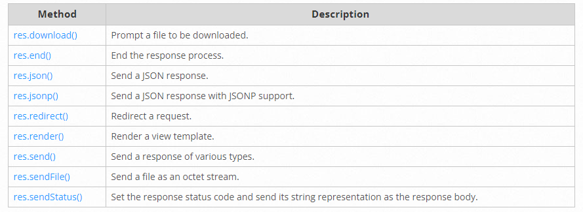
Response methods
The methods on the response object (res) in the following table can send a response to the client, and terminate the request-response cycle.
If none of these methods are called from a route handler, the client request will be left hanging.

Slide 110
app.route()
You can create chainable route handlers for a route path by using app.route().
Because the path is specified at a single location, creating modular routes is helpful, as is reducing redundancy and typos.
For more information about routes, see: Router() documentation.
Here is an example of chained route handlers that are defined by using app.route().
app.route('/book')
.get(function (req, res) {
res.send('Get a random book')
})
.post(function (req, res) {
res.send('Add a book')
})
.put(function (req, res) {
res.send('Update the book')
})

Slide 111
ExpressJS - RESTFul APIs

Slide 112
RESTful API — A RESTful API is an application program interface (API) that uses HTTP requests to GET, PUT, POST, and DELETE data.

Slide 113
What is a REST API?
A REST API (also known as RESTful API) is an application programming interface (API or web API) that conforms to the constraints of REST architectural style and allows for interaction with RESTful web services.
REST stands for representational state transfer and was created by computer scientist Roy Fielding.
What's an API?
An API is a set of definitions and protocols for building and integrating application software.
It’s sometimes referred to as a contract between an information provider and an information user—establishing the content required from the consumer (the call) and the content required by the producer (the response).
For example, the API design for a weather service could specify that the user supply a zip code and that the producer reply with a 2-part answer, the first being the high temperature, and the second being the low.

Slide 114
In other words, if you want to interact with a computer or system to retrieve information or perform a function, an API helps you communicate what you want to that system so it can understand and fulfill the request.
You can think of an API as a mediator between the users or clients and the resources or web services they want to get.
It’s also a way for an organization to share resources and information while maintaining security, control, and authentication—determining who gets access to what.
Another advantage of an API is that you don’t have to know the specifics of caching—how your resource is retrieved or where it comes from.

Slide 115
REST
REST is a set of architectural constraints, not a protocol or a standard.
API developers can implement REST in a variety of ways.
When a client request is made via a RESTful API, it transfers a representation of the state of the resource to the requester or endpoint.
This information, or representation, is delivered in one of several formats via HTTP: JSON (Javascript Object Notation), HTML, XLT, Python, PHP, or plain text.
JSON is the most generally popular file format to use because, despite its name, it’s language-agnostic, as well as readable by both humans and machines.

Slide 116
Something else to keep in mind:
Headers and parameters are also important in the HTTP methods of a RESTful API HTTP request, as they contain important identifier information as to the request's metadata, authorization, uniform resource identifier (URI), caching, cookies, and more.
There are request headers and response headers, each with their own HTTP connection information and status codes.

Slide 117
In order for an API to be considered RESTful, it has to conform to these criteria:
A client-server architecture made up of clients, servers, and resources, with requests managed through HTTP.
Stateless client-server communication, meaning no client information is stored between get requests and each request is separate and unconnected.
Cacheable data that streamlines client-server interactions.
A uniform interface between components so that information is transferred in a standard form.

Slide 118
This requires that:
resources requested are identifiable and separate from the representations sent to the client.
resources can be manipulated by the client via the representation they receive because the representation contains enough information to do so.
self-descriptive messages returned to the client have enough information to describe how the client should process it.
hypertext/hypermedia is available, meaning that after accessing a resource the client should be able to use hyperlinks to find all other currently available actions they can take.
A layered system that organizes each type of server (those responsible for security, load-balancing, etc.) involved the retrieval of requested information into hierarchies, invisible to the client.
Code-on-demand (optional): the ability to send executable code from the server to the client when requested, extending client functionality.

Slide 119
Middleware functions are functions that have access to the request object (req), the response object (res), and the next middleware function in the application’s request-response cycle.
These functions are used to modify req and res objects for tasks like parsing request bodies, adding response headers, etc.
Here is a simple example of a middleware function in action −
var express = require('express’);
var app = express();
//Simple request time logger
app.use(function(req, res, next){
console.log("A new request received at " + Date.now());
//This function call is very important. It tells that more processing is
//required for the current request and is in the next middleware
function route handler.
next();
}); app.listen(3000);

Slide 120
Cookies are simple, small files/data that are sent to client with a server request and stored on the client side. Every time the user loads the website back, this cookie is sent with the request. This helps us keep track of the user’s actions.
The following are the numerous uses of the HTTP Cookies −
Session management
Personalization(Recommendation systems)
User tracking
To use cookies with Express, we need the cookie-parser middleware. To install it, use the following code −
npm install --save cookie-parser

Slide 121
To use cookies with Express, we will require the cookie-parser.
cookie-parser is a middleware which parses cookies attached to the client request object.
To use it, we will require it in our index.js file; this can be used the same way as we use other middleware.
Here, we will use the following code.
var cookieParser = require('cookie-parser');
app.use(cookieParser());

Slide 122
cookie-parser parses Cookie header and populates req.cookies with an object keyed by the cookie names.
To set a new cookie, let us define a new route in your Express app like −
var express = require('express');
var app = express();
app.get('/', function(req, res){
res.cookie('name', 'express').send('cookie set'); //Sets name = express
});
app.listen(3000);
console.log('Cookies: ', req.cookies);

Slide 123
Adding Cookies with Expiration Time
You can add cookies that expire. To add a cookie that expires, just pass an object with property 'expire' set to the time when you want it to expire. For example,
//Expires after 360000 ms from the time it is set.
res.cookie(name, 'value', {expire: 360000 + Date.now()});
res.cookie(name, 'value', {maxAge: 360000});

Slide 124
Deleting Existing Cookies
To delete a cookie, use the clearCookie function. For example, if you need to clear a cookie named foo, use the following code.
var express = require('express');
var app = express();
app.get('/clear_cookie_foo', function(req, res){
res.clearCookie('foo');
res.send('cookie foo cleared');
});
app.listen(3000);

Slide 125
ExpressJS – Sessions:
HTTP is stateless; in order to associate a request to any other request, you need a way to store user data between HTTP requests.
Cookies and URL parameters are both suitable ways to transport data between the client and the server.
But they are both readable and on the client side. Sessions solve exactly this problem.
You assign the client an ID and it makes all further requests using that ID. Information associated with the client is stored on the server linked to this ID.
npm install --save express-session

Slide 126
var express = require('express');
var cookieParser = require('cookie-parser');
var session = require('express-session');
var app = express();
app.use(cookieParser());
app.use(session({secret: "Shh, its a secret!"}));
app.get('/', function(req, res){
if(req.session.page_views){
req.session.page_views++;
res.send("You visited this page " + req.session.page_views + " times");
} else {
req.session.page_views = 1;
res.send("Welcome to this page for the first time!");
}
});
app.listen(3000);

Slide 127
ExpressJS – Authentication
Authentication is a process in which the credentials provided are compared to those on file in a database of authorized users' information on a local operating system or within an authentication server.
If the credentials match, the process is completed and the user is granted authorization for access.
For us to create an authentication system, we will need to create a sign up page and a user-password store.
The following code creates an account for us and stores it in memory.
This is just for the purpose of demo; it is recommended that a persistent storage (database or files) is always used to store user information.

Slide 128
var express = require('express');
var app = express();
var bodyParser = require('body-parser');
var multer = require('multer');
var upload = multer();
var session = require('express-session');
var cookieParser = require('cookie-parser');
app.set('view engine', 'pug');
app.set('views','./views');
app.use(bodyParser.json());
app.use(bodyParser.urlencoded({ extended: true }));
app.use(upload.array());
app.use(cookieParser());
app.use(session({secret: "Your secret key"}));

Slide 129
var Users = [];
app.get('/signup', function(req, res){
res.render('signup');
});
app.post('/signup', function(req, res){
if(!req.body.id || !req.body.password){
res.status("400");
res.send("Invalid details!");
} else {
Users.filter(function(user){
if(user.id === req.body.id){
res.render('signup', {
message: "User Already Exists! Login or choose another user id"});
}
});

Slide 130
var newUser = {id: req.body.id, password: req.body.password};
Users.push(newUser);
req.session.user = newUser;
res.redirect('/protected_page');
}
});
app.listen(3000);

